Slide 1
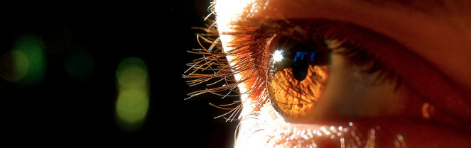
Visión por Computador
Domingo Mery
Departmento de Ciencia de la Computación
Escuela de Ingeniería
Universidad Católica de Chile
Parameter Estimation in Geometry

Slide 2
[ Example ]

Slide 3
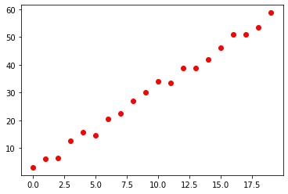
[ Example: Estimation of a line ]
MODEL
(for each point: 1 equation)

Slide 4
[ Solution ]

Slide 5
[ Solution 1 ]

Slide 6
[ Solution 1 ]
a_prime = np.linalg.lstsq(Q, r, rcond=None)[0]

Slide 7
[ Solution 2 ]
(last column of V)
[U,S,V] = np.linalg.svd(X)
a_hat = V[-1,:]

Slide 8
[ Example: Estimation of a line ]
MODEL
(for each point: 1 equation)
SOLUTION

Slide 9
[ In Computer Vision ]
Homography
Camera Calibration
Fundamental Matrix

Slide 10
[ In Computer Vision ]
Homography
Camera Calibration
Fundamental Matrix

Slide 11
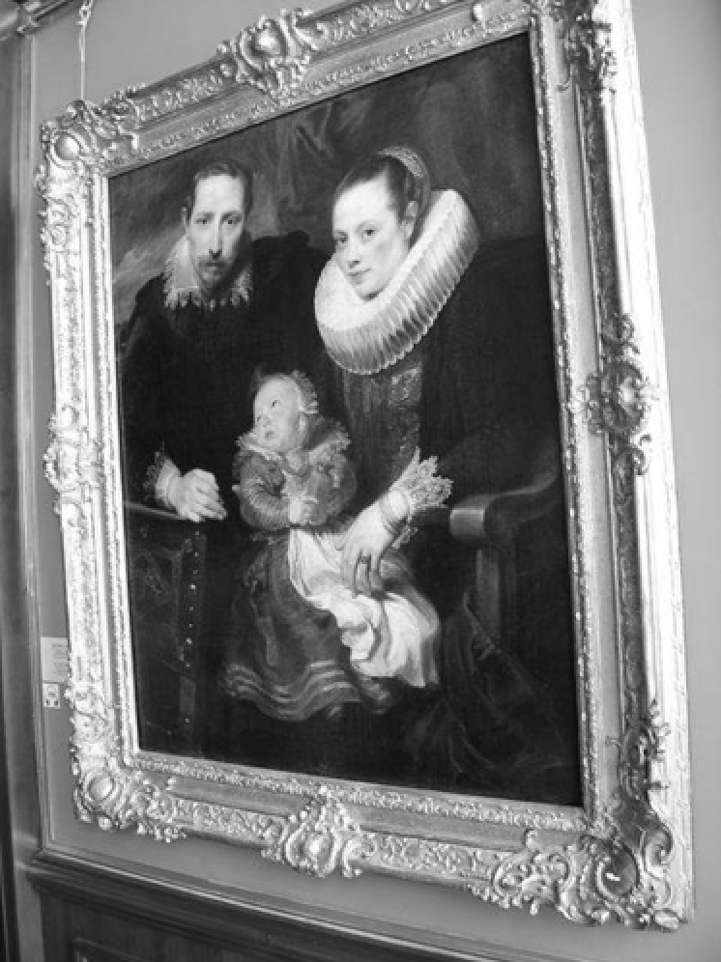
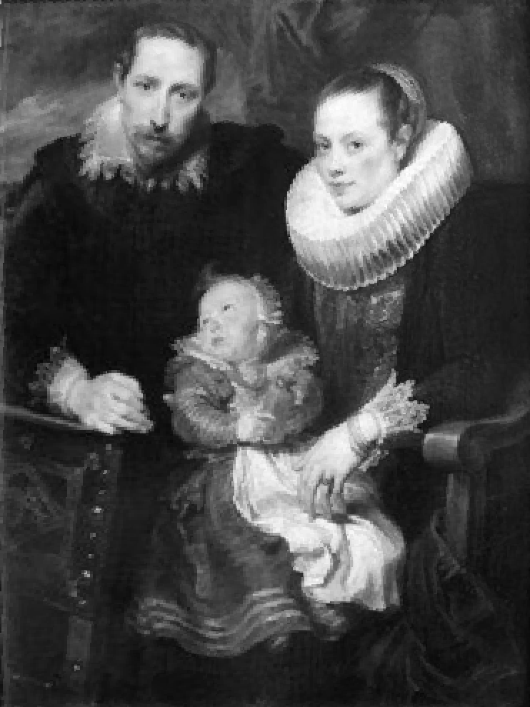
[ Homography ]
y’
y
m
m’
x
x’
MODEL

Slide 12
[ Homography ]
CORRESPONDENCE:
(for each correspondence: 2 equations)

Slide 13
[ Homography ]

Slide 14
[ In Computer Vision ]
Homography
Camera Calibration
Fundamental Matrix

Slide 15
[ Camera Calibration ]
m
M
C
MODEL

Slide 16
[ Camera Calibration ]
CORRESPONDENCE:
(for each correspondence: 2 equations)

Slide 17
[ Camera Calibration ]

Slide 18
[ In Computer Vision ]
Homography
Camera Calibration
Fundamental Matrix

Slide 19


[ Fundamental Matrix: Epipolar Geometry ]
2
3
2
3
1
4
1
4
5
9
5
9
6
8
6
8
7
I₁
7
I₂
Epipolar
Line
MODEL

Slide 20
[ Fundamental Matrix: Epipolar Geometry ]
CORRESPONDENCE:
(for each correspondence: 1 equation)

Slide 21
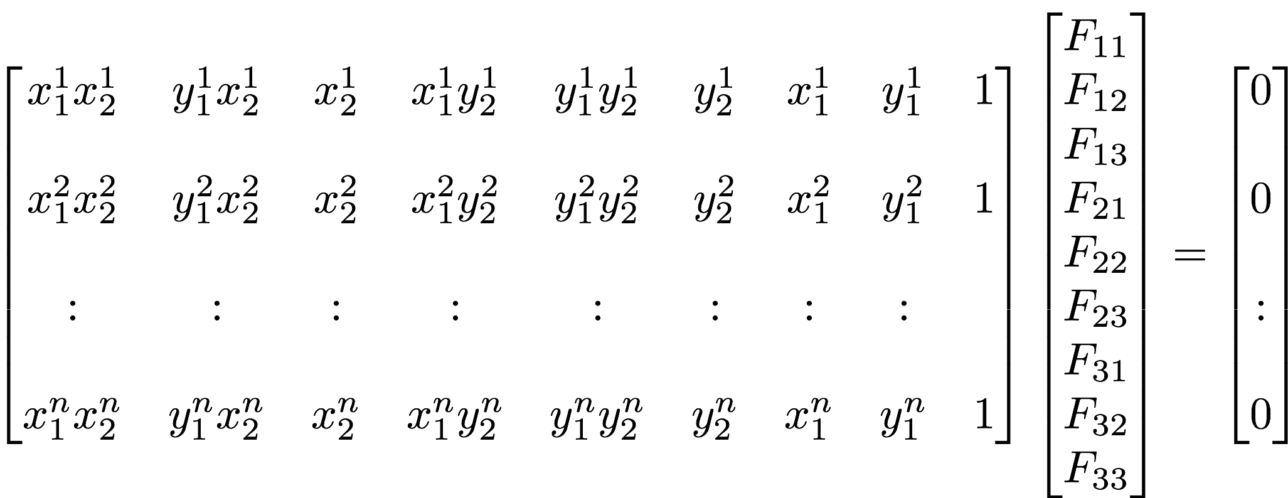
[ Fundamental Matrix: Epipolar Geometry ]

Slide 22
[ Outliers ]

Slide 23
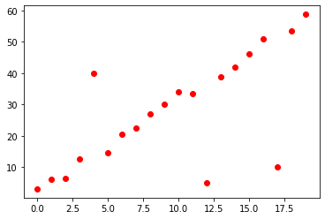
[ Example: Estimation of a line - OUTLIERS ]
MODEL
(for each point: 1 equation)
SOLUTION

Slide 24
RANSAC
[ How to remove the OUTLIERS ]

Slide 25
RANSAC
[ How to remove the OUTLIERS ]
1. Select random 2 points

Slide 26
RANSAC
[ How to remove the OUTLIERS ]
1. Select random 2 points
2. Estimate the line

Slide 27
RANSAC
[ How to remove the OUTLIERS ]
1. Select random 2 points
2. Estimate the line
3. Define a tolerance range

Slide 28
RANSAC
[ How to remove the OUTLIERS ]
1. Select random 2 points
2. Estimate the line
3. Define a tolerance range
4. Count the outliers

Slide 29
RANSAC
[ How to remove the OUTLIERS ]
1. Select random 2 points
2. Estimate the line
3. Define a tolerance range
4. Count the outliers
5. Repeat N times and select
the line that minimizes the number of outliers

Slide 30
RANSAC
[ How to remove the OUTLIERS ]
1. Select random 2 points^{(*)}
2. Estimate the line
3. Define a tolerance range
4. Count the outliers
5. Repeat N times and select
the line that minimizes the number of outliers
^{(*)}
Minimal number of points to estimate the parameters of the model

Slide 31
SIFT matching points
[ In Computer Vision ]
Homography
Camera Calibration
Fundamental Matrix
Corner detection (Chess)
Corresponding points can be found automatically…
Outliers can be removed using RANSAC

